Slide 1

OLyMPIX: Olympic Data visualisation tool
Course: CS661 – Big Data Visual Analytics Instructor: Prof. Soumya Dutta
Group: 21

Slide 2

InTRODUCTION
What is Olympix?
- An interactive data visualization platform showcasing Olympic Games statistics.
- Designed for sports lovers to explore events, stats, and more.
Features:
- Data sourced from Kaggle Datasets.
- Technologies: React.js for the frontend, D3.js for dynamic data visualizations.

Slide 3

Medal Dashboard
Features:
- Map-Based Visualization.
- Continent Analysis
- Rankings based on gold, silver, bronze, and total medals.
Medal Trends

Slide 4
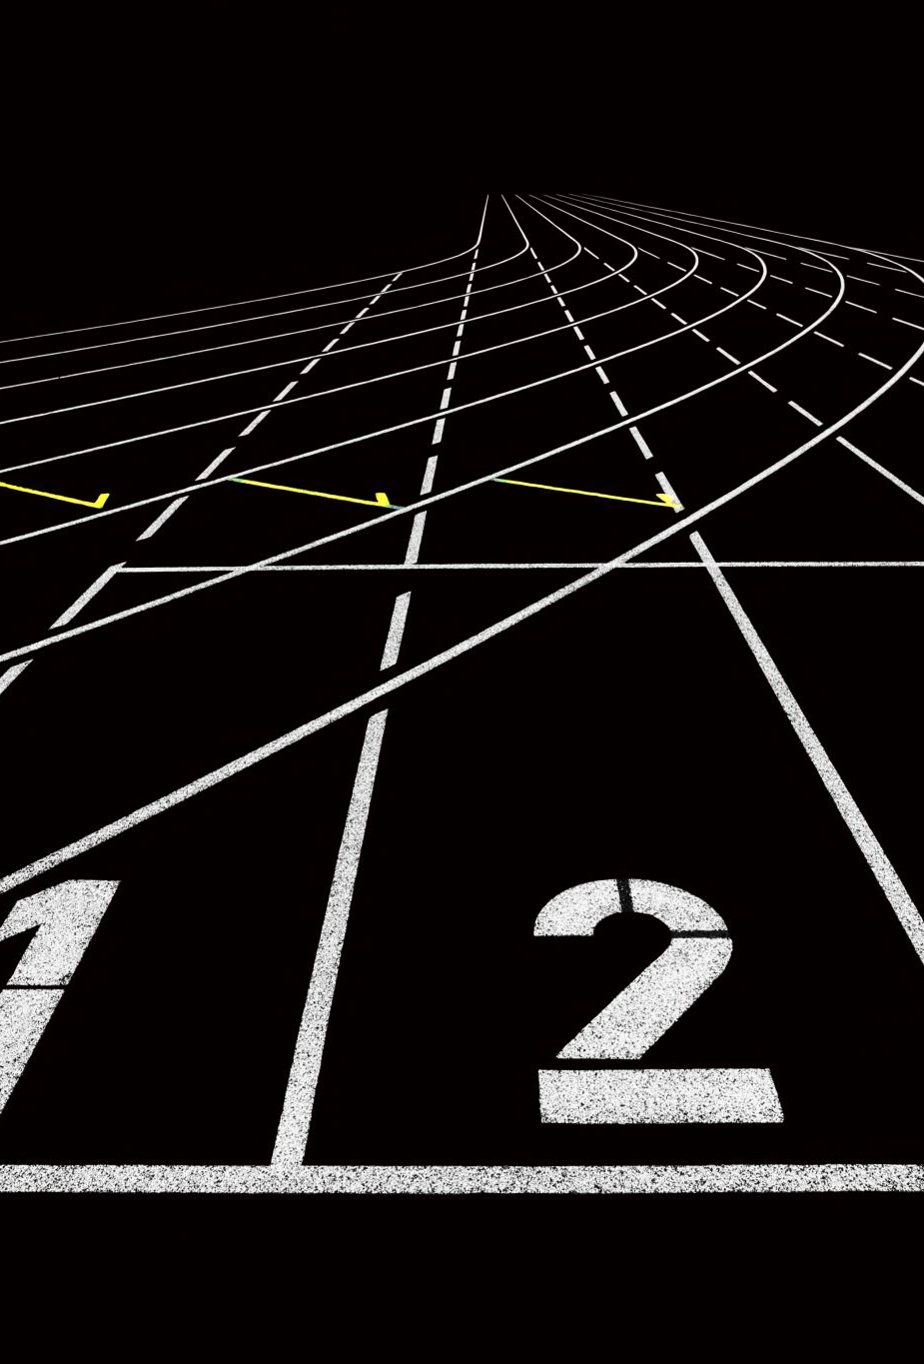
Age vs Performance
Features:
- Age distribution
- Peak Performance Age
- Age Trends Over Time
Age by Sport

Slide 5

Gender Participation
Features:
- Line charts depicting male vs. female participation over the years.
- Highlights of milestones in gender equality.
- Breakdown by sport and country.

Slide 6
SPORTS Analysis
Number of sports events over the years
Countries participation w.r.t number of sports

Slide 7
COUNTRY Analysis
Comparison among countries
Country wise analysis

Slide 8

Thank you
Now we will move on to the demo -
Contributors: Abhijeet Agarwal
Akshat Singh Tiwari
Asjad Raza
Bedant Sharma
Harsh Verma Havi Bohra

